Slide 1


Project Title : Honeypot Analysis
UNDER GUIDED BY
Mr.Dattaraj Sadguru Shetye
Group No. : DITISS 01
Presented by:
Kushare Vishal Nivrutti(240850123012)
Sanjay Kumar Das (240850123021)
Ved Prakash Verma (240850123033)
Vipul Kumar Jaltare (240850123036)
Makrand Shrirang Chandanshive 240850123013

Slide 2
Introduction
What is Honeypot Analysis ?
Honeypot analysis deploys decoy systems to attract attackers, enabling us to observe their methods. This project examines the principles of honeypot analysis and its role in threat detection. By analyzing interactions with these decoys, we can gain insights into attack patterns and enhance security measures to improve defenses against cyber threats.
Objective of the project: To develop a honeypot analysis system for monitoring and analyzing cyber attack patterns using low-interaction and
high-interaction honeypots.

Slide 3
History of Honeypot
Early Concepts (1980s):
The idea of using decoy systems to lure attackers dates back to the early days of computing. Researchers recognized the potential for using fake systems to study and analyze cyber threats.
First Honeypots (1990s):
The first formal honeypots were developed in the 1990s. The "Honeynet Project," initiated by researchers like Lance Spitzner, aimed to create a network of honeypots to collect data on attacks.
Current State:
Honeypots are now widely recognized as valuable tools in cybersecurity. They continue to evolve to meet the challenges posed by increasingly sophisticated cyber threats.

Slide 4
Problem Statement
Honeypot analysis works by using fake systems that attract cybercriminals.
Many organizations find it difficult to detect and respond to these attacks effectively.
Standard security measures often miss new types of threats and don’t reveal how attackers operate.
This project aims to create a system for analyzing honeypots to better understand and prevent cyber threats.

Slide 5
Objectives
Understand Attacker Behavior: To study how cybercriminals operate and what tricks they use when they interact with honeypots.
Collect Threat Intelligence: To gather data on attack patterns, tools, and techniques employed by attackers.
Improve Detection Capabilities: To enhance existing security measures by identifying new threats and vulnerabilities.
Evaluate Security Policies: To assess the effectiveness of current cybersecurity policies and practices based on insights gained from honeypot interactions.

Slide 6
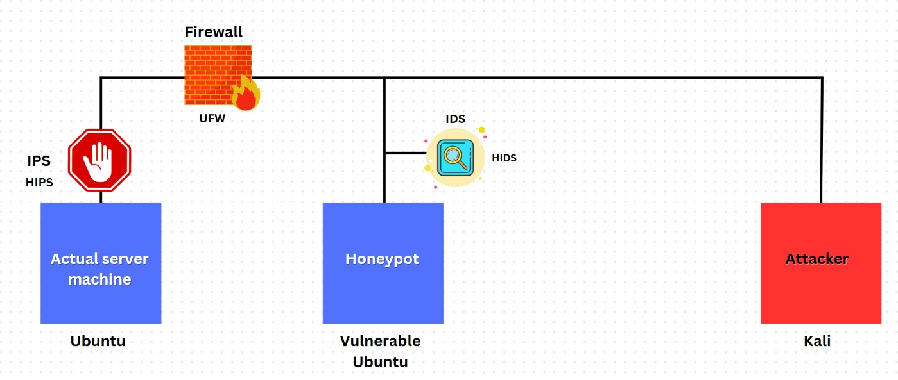
System Architecture

Slide 7
Types of Honeypots
Low-Interaction Honeypots
Low interaction’ means exactly that, the adversary will not be able to interact with your decoy system in any depth, as it is a much more static environment. A low interaction honeypot will usually emulate a small amount of internet protocols and network services
High-Interaction Honeypots
A high interaction honeypot is a decoy system that allows attackers to interact with a vulnerable operating system. This type of honeypot is designed to give attackers full access to the system so that researchers can observe their activities.

Slide 8

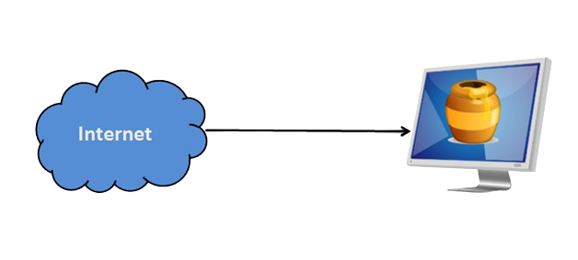
Benefits of Honeypot Analysis
Gain Insights into Emerging Threats
Test Effectiveness of Security Measures
Gather Threat Intelligence
Improve Security Posture
Facilitate Research and Development
Test Effectiveness of Security Measures

Slide 9
Data Collection and Analysis
IP Addresses: Identify the sources of attacks.
Attack Methods: Document techniques used by attackers (e.g., SQL injection, phishing,).
Timestamps: Record the timing of attacks for trend analysis.
Payloads: Capture the actual data sent during attacks to analyze malicious content.
Session Information: Track the duration and nature of interactions with the honeypot.

Slide 10


System Tools and techniques
Kali Linux Os (4GB Ram 30GB Storage)
Ubuntu Os (6GB Ram 40GB Storage)
Nmap
Wireshark
IDS
IPS
ELK

Slide 11
Use Cases of Honeypot Analysis
Incident Response Preparation:
Real-Time Monitoring: Honeypots allow teams to observe attacks in action, enhancing understanding of attacker behavior.
Response Plans: Insights from honeypot interactions inform and refine incident response strategies.
Testing Protocols: Organizations can practice incident response procedures, identifying weaknesses and improving team coordination.
Enhancing Overall Cybersecurity Posture:
Vulnerability Identification: Honeypots expose weaknesses in security measures by attracting attackers.
Policy Improvement: Data collected informs updates to security policies and practices.
Training and Awareness: Real-world examples from honeypots enhance training for security personnel, increasing awareness of potential risks.

Slide 12
Challenges and Limitations of Honeypot Analysis
Resource Requirements:
High-interaction honeypots need a lot of computer power, memory, and storage, making them expensive and harder to manage.
Risk of Compromise:
Attackers might break into honeypot systems, which could lead to them being used for other attacks or stealing data.
Recognition and Avoidance:
Experienced attackers might spot honeypots and avoid them, which means they won’t provide useful information about real attack methods.

Slide 13
Conclusion
Importance of Honeypot Analysis:
Helps organizations understand attacker behavior and tactics.
Gathers valuable information about emerging threats.
Improves security measures and incident response strategies.
Future Directions and Advancements:
Continued evolution of honeypot technology to keep up with changing cyber threats.
Improved ability to identify patterns and predict future threats.

Slide 14
Thank You

